Slide 1
Scala Backend - Project
Event Management System
Visitor Management System
Mano Ranjan Narayanasamy

Slide 2
Event Management System

Slide 3
Project Summary
An event management company specializes in organizing and coordinating various services for events like weddings, corporate gatherings, and private parties. They need an Event Management Service Coordination System to help the event manager assign tasks to different service teams, track preparation timelines, and send notifications to ensure everything is ready for the event day. The system will involve a single user (the event manager) who coordinates multiple teams.

Slide 4
System Requirements
A event manager user can register and add event.
Event Manager will assigning the teams to the registered event .
Event can be updated based on teams availability on the scheduled date.
Notification will be triggered to the assigned teams.

Slide 5
System Requirements
Email Notification:
An mail notification will be triggered to the sent to the assigned team:
Catering Team
Security Team
Transportation Team
Medical Team

Slide 6
System Requirements
Backend and Deployment
The system should be developed as a Play Framework web application, with a REST API to manage teams, assign tasks etc
A separate microservice will be created using Akka Actors to handle messaging to the teams.
Container based deployment is being done on the application which makes application portable and faster deployment.

Slide 7
System Requirements
Security:
JWT Token based authentication implementation on the team and even managing endpoints.

Slide 8
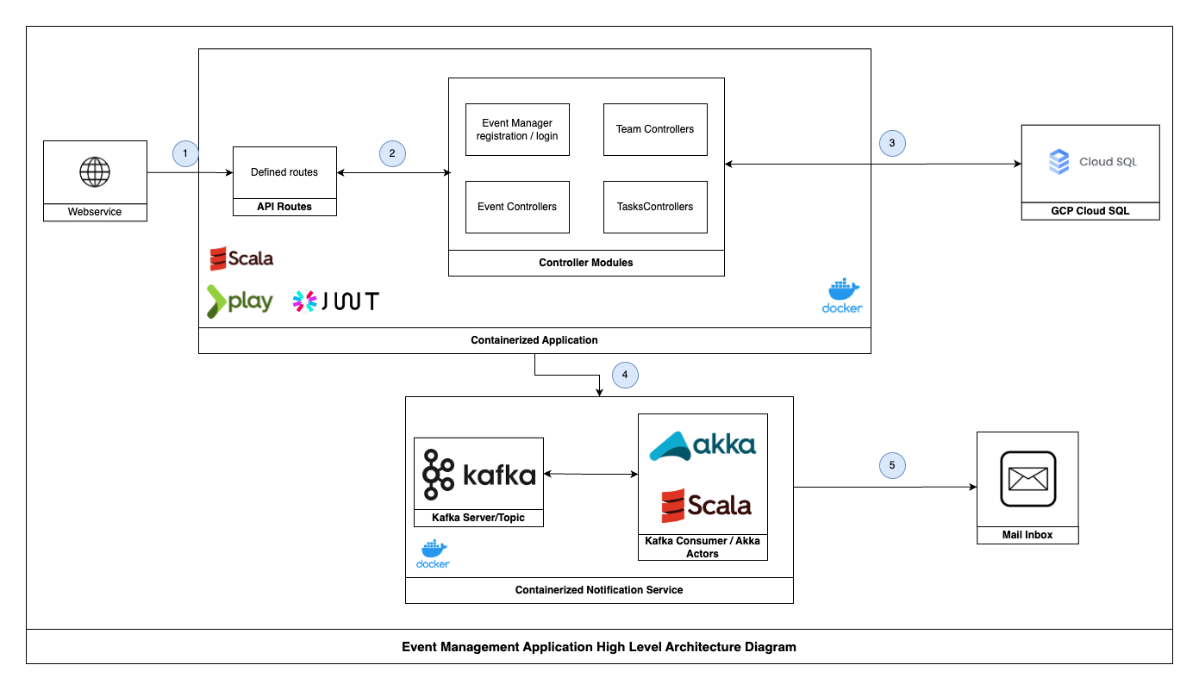
Application Architecture Diagram

Slide 9
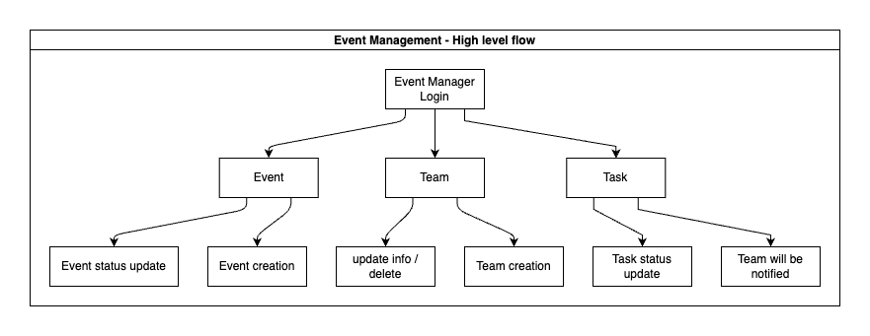
Flow Diagram

Slide 10
Visitor Management System

Slide 11
Project Summary
A corporate office requires a Visitor Management System to streamline visitor check-in, check-out, and service coordination. This system should allow reception staff to manage visitor entry and exit while notifying relevant internal teams of visitor arrivals.

Slide 12
System Requirement
Visitor check-in and check-out:
Receptionist can check in visitors and collect essential details id number, name, contact information, purpose of visit.
Receptionist can manage the visitor details like checkin and checkout timings and token based validation implemented on this endpoint only receptionist can able to perform this operation.

Slide 13
System Requirement
Backend and Deployment
The system should be developed as a Play Framework web application, with a REST API to manage teams, assign tasks etc
A separate microservice will be created using Akka Actors to handle messaging to the teams.
Container based deployment is being done on the application which makes application portable and faster deployment.

Slide 14
System Requirements
Notification System:
An Email based notification will triggered to IT, SECURITY, EMPLOYEE HOST for further action to take.
Security:
JWT Token based authentication implementation on the team and even managing endpoints.

Slide 15
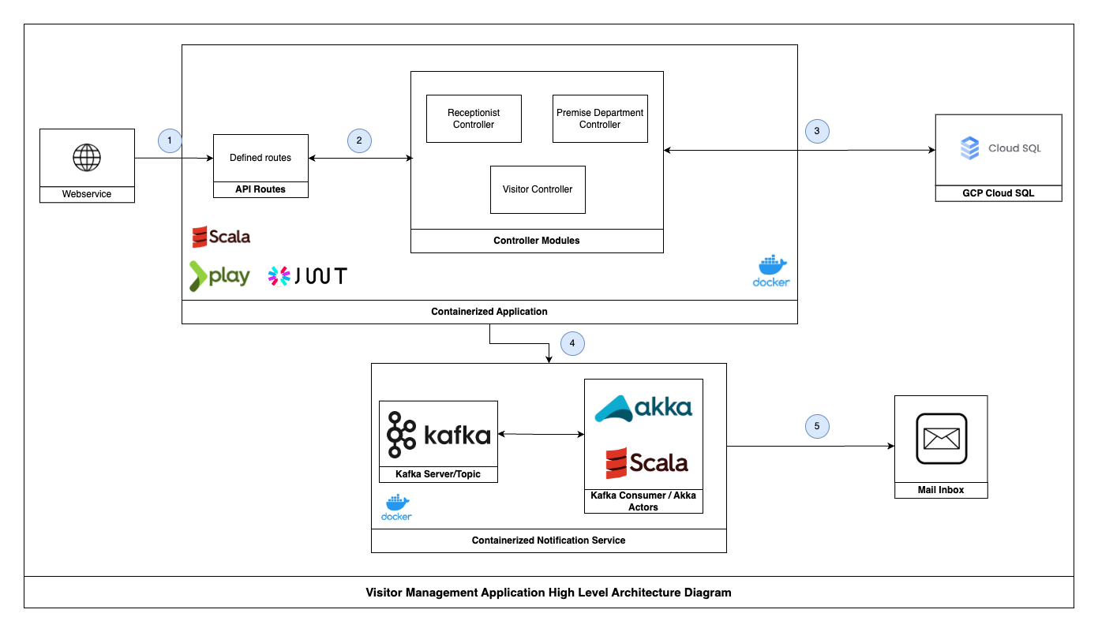
Application Architecture Diagram

Slide 16
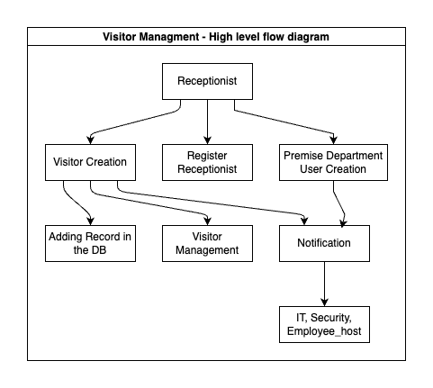
Flow Diagram

